Slide 1





Home Credit Scorecard Model
Project Based Intern : Data Science
Created by:
Muhammad Ariq Arfina
ariqarfina05@gmail.com
LinkedIn : Muhammad Ariq Arfina
Github : ariqarfina
Link to
File ->

Slide 2

Step 1
Problem Understanding
Step 2
Data Overview & Exploratory Data Analysis
Home Credit Scorecard Model
Outline
Step 3
Data Pre-Processing & Feature Selection
Step 4
Model & Evaluation
Step 5
Conclusion

Slide 3

Home Credit Scorecard Model
Project Based Intern : Data Science
Problem
Understanding

Slide 4

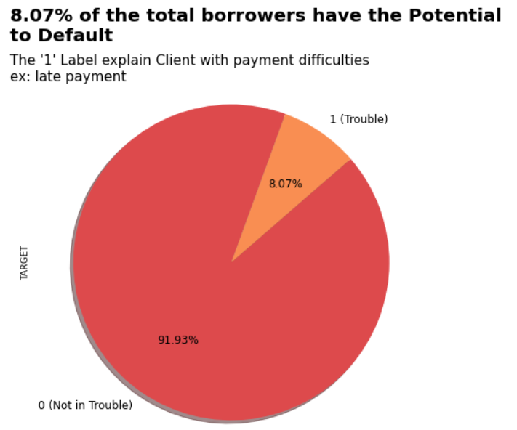
Problem Understanding
Problem statement:
The loss generated by non-paying customers is quite high. (8,07%)
Goals:
Predicting potential customers who can borrow money with minimum risk
Objective:
Help minimize these losses by using predictive models to predict customers who are likely to default.
Use AUC and Kolmogorov-Smirnov (KS) with target:
- AUC : 0,7
- KS : 0,3
Business Metrics:
Lost Given Default (LGD)
Link to File ->

Slide 5
Home Credit Scorecard Model
Project Based Intern : Data Science
Data Overview &
Exploratory Data Analysis

Slide 6
Data Overview
Table | Description
application_{train|test}.csv | This is the main table, broken into two files for Train (with TARGET) and Test (without TARGET). Static data for all applications. One row represents one loan in our data sample. | POS_CASH_balance.csv | Monthly balance snapshots of previous POS (point of sales) and cash loans that the applicant had with Home Credit. This table has one row for each month of history of every previous credit in Home Credit (consumer credit and cash loans) related to loans in our sample – i.e. the table has (#loans in sample * # of relative previous credits * # of months in which we have some history observable for the previous credits) rows.
bureau.csv | All client's previous credits provided by other financial institutions that were reported to Credit Bureau (for clients who have a loan in our sample). For every loan in our sample, there are as many rows as number of credits the client had in Credit Bureau before the application date. | credit_card_balance.csv | Monthly balance snapshots of previous credit cards that the applicant has with Home Credit. This table has one row for each month of history of every previous credit in Home Credit (consumer credit and cash loans) related to loans in our sample – i.e. the table has (#loans in sample * # of relative previous credit cards * # of months where we have some history observable for the previous credit card) rows.
bureau_balance.csv | Monthly balances of previous credits in Credit Bureau. This table has one row for each month of history of every previous credit reported to Credit Bureau – i.e the table has (#loans in sample * # of relative previous credits * # of months where we have some history observable for the previous credits) rows. | previous_application.csv | All previous applications for Home Credit loans of clients who have loans in our sample. There is one row for each previous application related to loans in our data sample.
 |  | installments_payments.csv | Repayment history for the previously disbursed credits in Home Credit related to the loans in our sample. There is one row for every payment that was made plus and one row each for missed payment. One row is equivalent to one payment of one installment OR one installment corresponding to

Slide 7
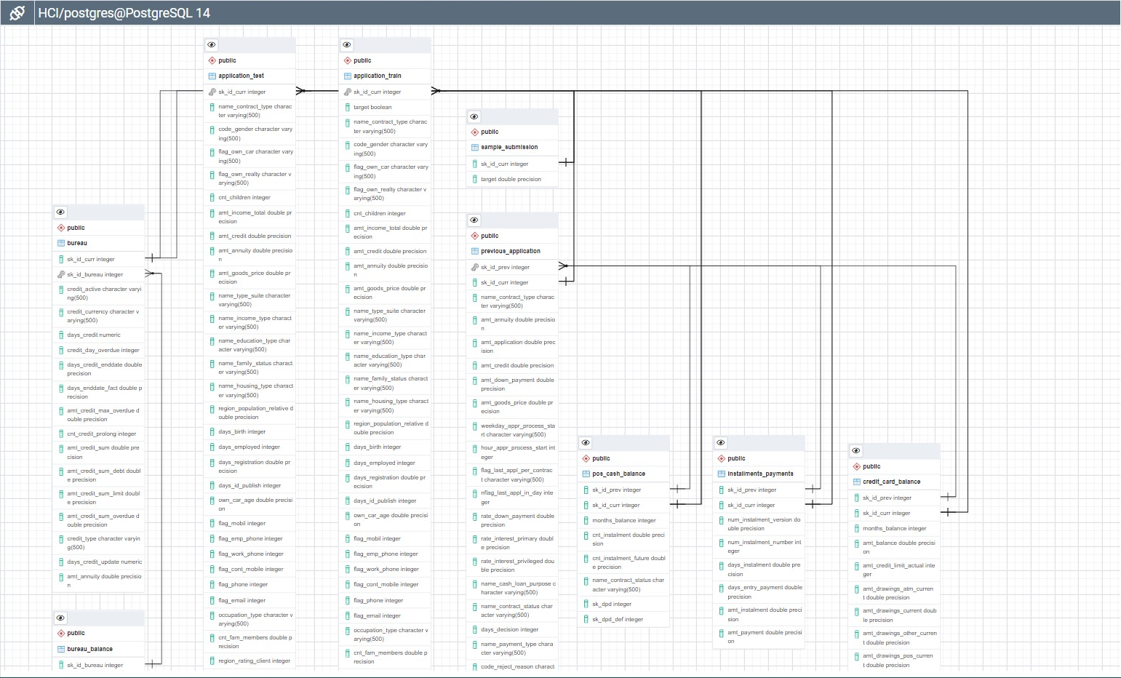
Data Overview
Link to File ->

Slide 8

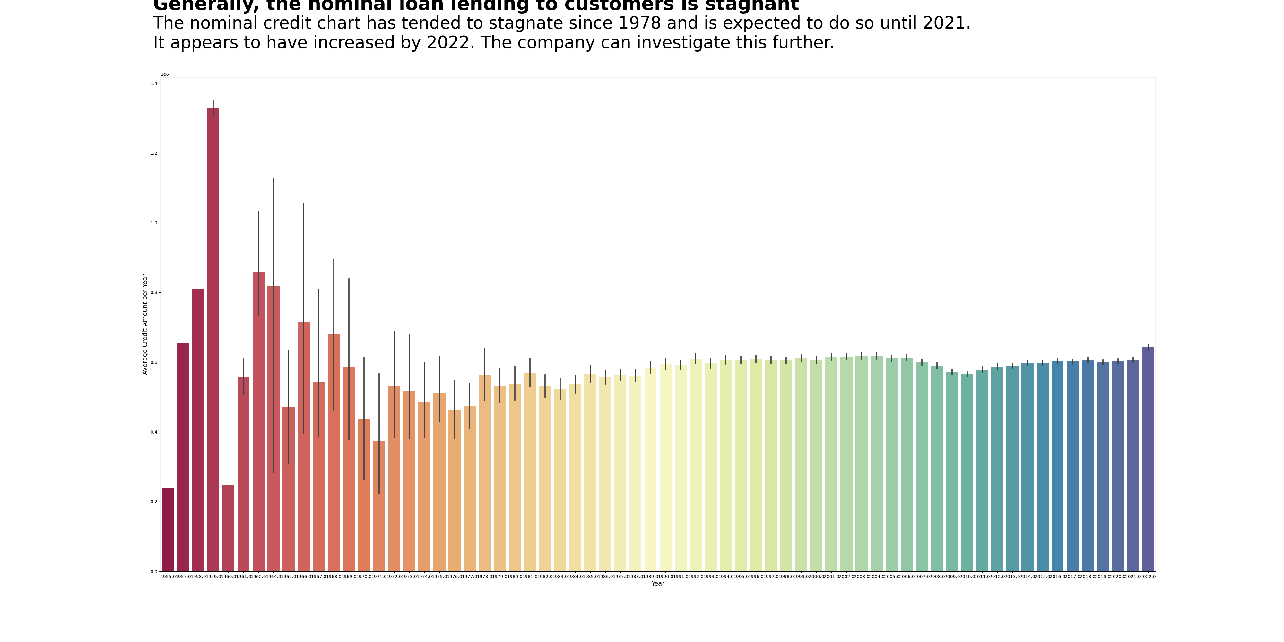
Exploratory Data Analysis
Link to File ->

Slide 9
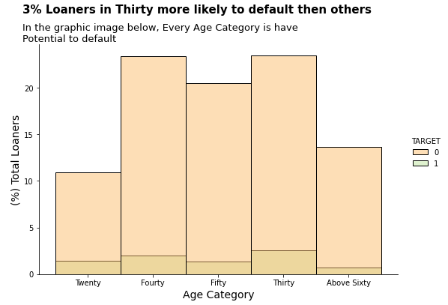
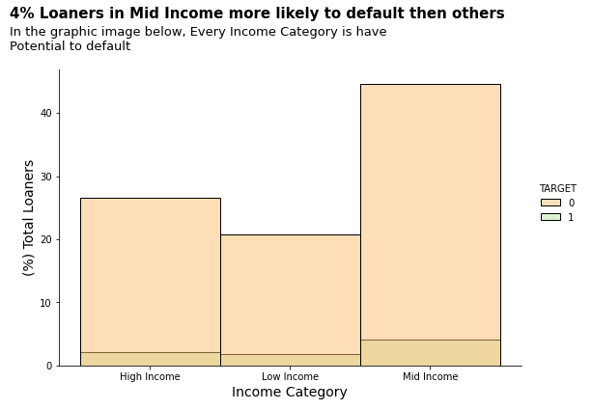
Exploratory Data Analysis
Link to File ->

Slide 10
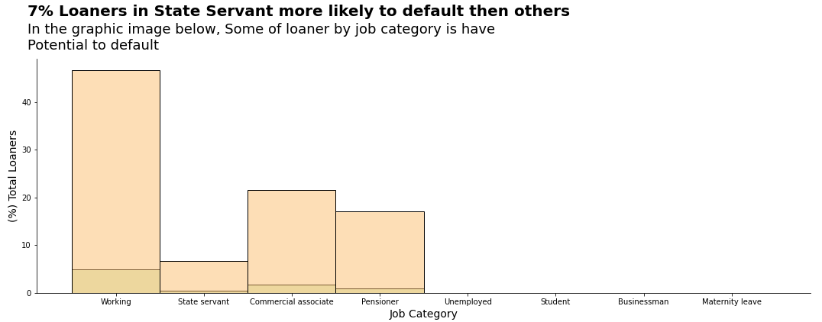
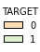
Exploratory Data Analysis
Link to File ->

Slide 11
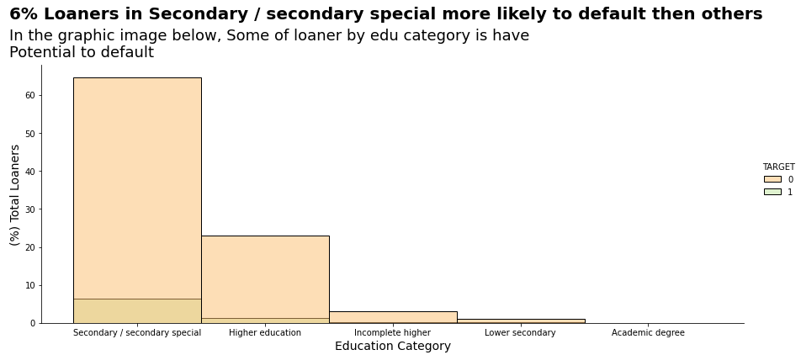
Exploratory Data Analysis
Link to File ->

Slide 12
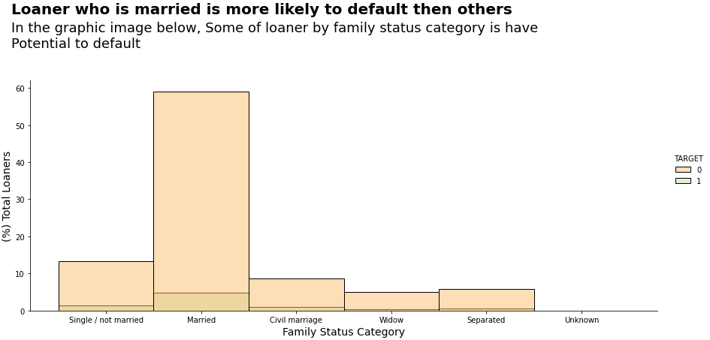
Exploratory Data Analysis
Link to File ->

Slide 13
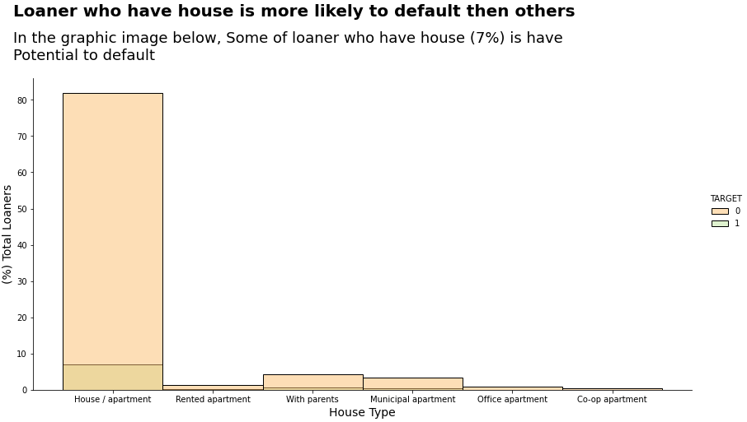
Exploratory Data Analysis
Link to File ->

Slide 14
Home Credit Scorecard Model
Project Based Intern : Data Science
Data Pre-Processing &
Feature Selection

Slide 15
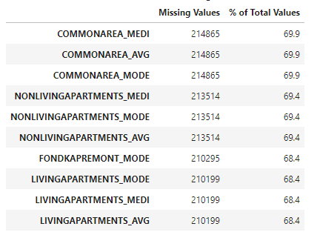
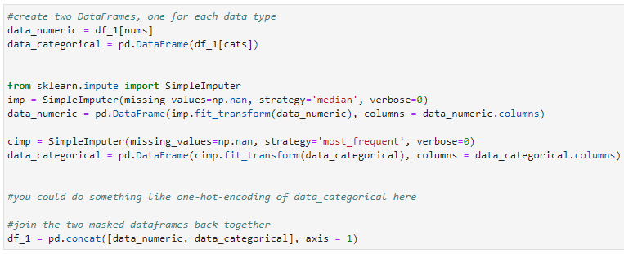
Data Pre-Processing & Exploratory Data Analysis
Drop Missing Value (<68.4% from Dataset)
Input Missing Value with Single Imputer
Link to File ->

Slide 16
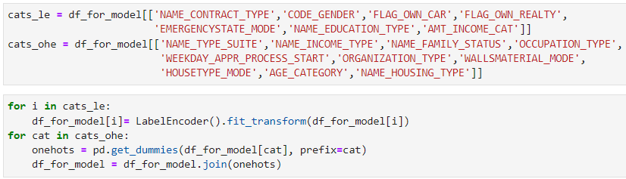
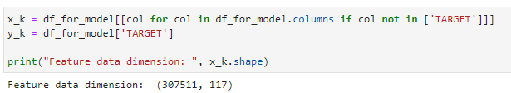
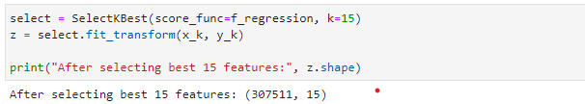
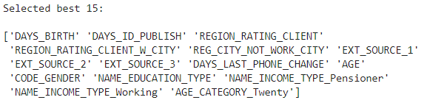
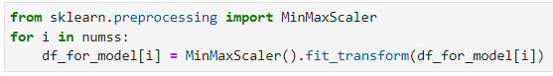
Data Pre-Processing & Exploratory Data Analysis
Feature Encoding
Feature Selection using SelectKBest
MinMaxScaler
Link to File ->

Slide 17
Home Credit Scorecard Model
Project Based Intern : Data Science
Model & Evaluation

Slide 18
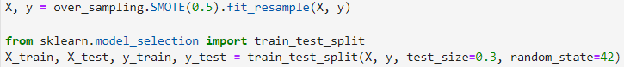
Model & Evaluation
Train Test Split & Handling Imbalance Data
Feature :
'DAYS_BIRTH’
'DAYS_ID_PUBLISH’
'REGION_RATING_CLIENT’
'REGION_RATING_CLIENT_W_CITY' 'REG_CITY_NOT_WORK_CITY’
'EXT_SOURCE_1’
'EXT_SOURCE_2’
'EXT_SOURCE_3’
'DAYS_LAST_PHONE_CHANGE’
'AGE', 'CODE_GENDER’
'NAME_EDUCATION_TYPE’
'NAME_INCOME_TYPE_Pensioner', 'NAME_INCOME_TYPE_Working’
'AGE_CATEGORY_Twenty'
Target :
‘TARGET’
Imbalance using SMOTE
Link to File ->

Slide 19
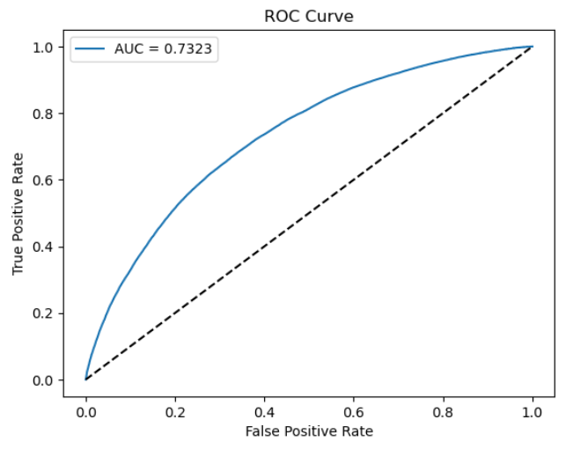
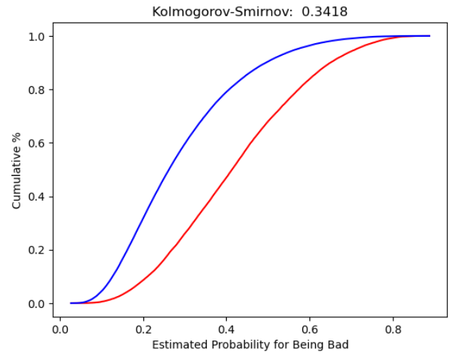
Model & Evaluation
Model :
Logistic Regression
Model Evaluation:
AUC & KS
Evaluation | Model
 | Logistic Regression
AUC (Train Set) | 0.73
AUC (Test Set) | 0.73
KS (Test Set) | 0.3418
Link to File ->

Slide 20
Home Credit Scorecard Model
Project Based Intern : Data Science
Conclusion

Slide 21
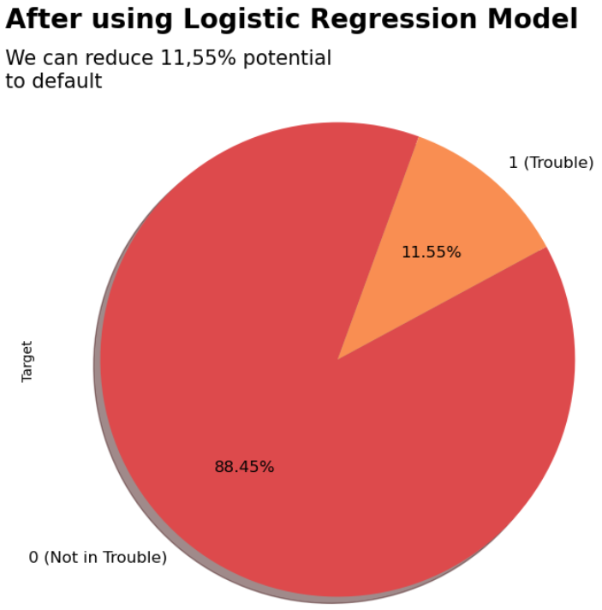
Conclusion
Before and After using model:
Before we use the model, we know that 8,07 % of Customers indicated failure from data train.
We can predict that 11.55 % of the Test Data will default based on our modeling. As a result, customers who are expected to fail to pay can have their applications canceled.
Loss generate (Before using Model) Using Previous Data | Loss generate (After using Model) Using Data Test
8,07% Default | 11,55% Predicted Default
Link to File ->

Slide 22
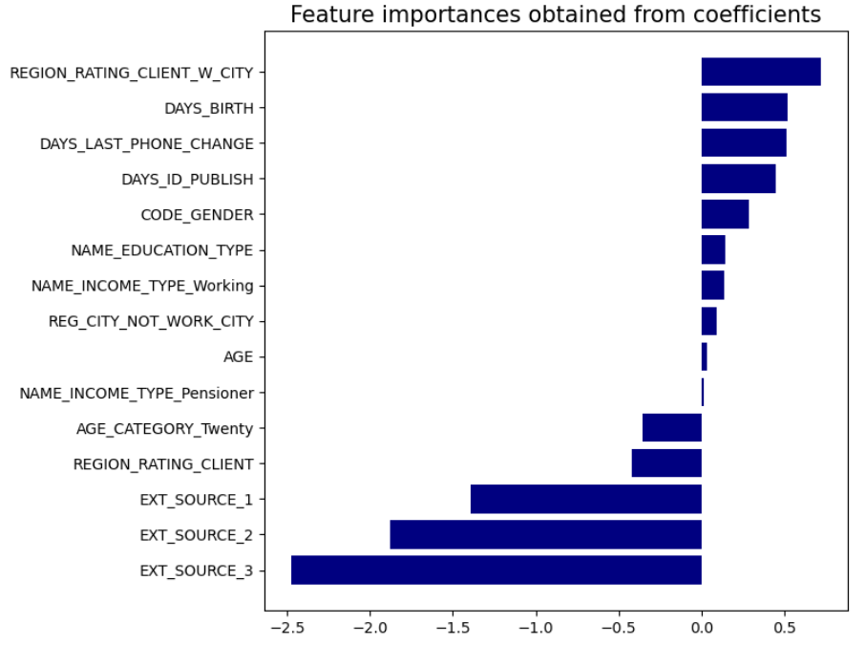
Feature Importance
Top 3 Feature Importance that give more impact is:
Region Rating Client W City
Days Birth
Days Last Phone Change
Link to File ->

Slide 23
Home Credit Scorecard Model
Thank You
Created by:
Muhammad Ariq Arfina
ariqarfina05@gmail.com
LinkedIn : Muhammad Ariq Arfina
Github : ariqarfina
Project Based Intern : Data Science

